Slide 1

PitStop Manager
A Lightweight Java Web Application for Racing Data Management
A Mini project report submitted by
JAYASRI B 241801101
JAYASREE D 241801100

Slide 2



Project Overview: PitStop Manager
Core Technology
Data Storage
Primary Purpose
Developed in Java using the lightweight Spark Java Micro Web Framework for rapid development.
Persistent data handling via MySQL database, managed through standard JDBC connections.
Management system for tracking and reporting Formula 1-style racing data, including results and teams.
Key Features Summary
CRUD operations for Teams, Racers, Races, and Results.
Integrated REST API for data access.
Dynamic Web Interface for user interaction.
Live Leaderboard display with real-time updates.

Slide 3


System Architecture: Data Flow
PitStop Manager uses a classic three-tier architecture to ensure clear separation of concerns and maintainability.
Browser
Java Spark Server
MySQL Database
JSON Response
This micro-framework approach prioritizes speed and low overhead, making it ideal for a focused data management tool.

Slide 4



Technology Stack Breakdown
A curated selection of modern, lightweight technologies was chosen for efficiency and performance.
Frontend
Backend
Database & Data Layer
Standard HTML, CSS, and vanilla JavaScript for a responsive and dynamic user experience.
Java coupled with the minimal and efficient Spark Java Framework handles routing and business logic.
MySQL for robust persistence, accessed via JDBC; Gson Library for seamless JSON serialization/deserialization.
All structured data can be easily exported to Excel/CSV for external reporting or advanced analytics.

Slide 5
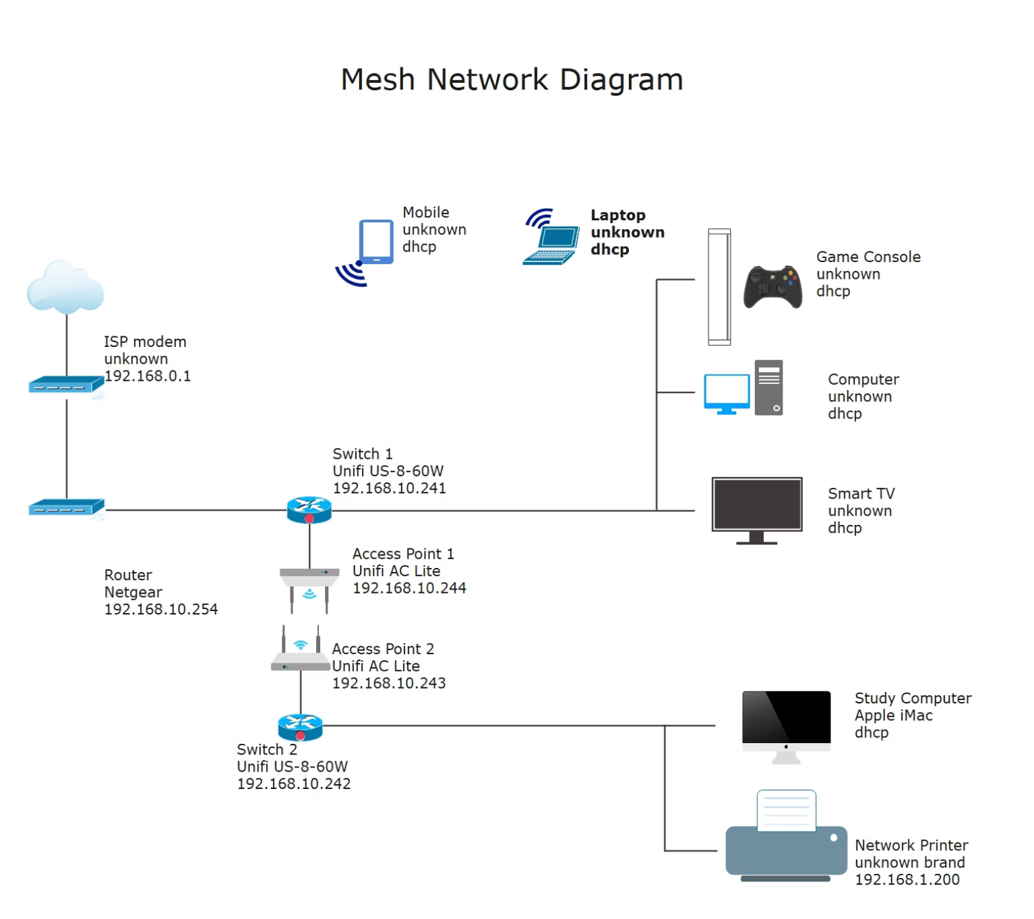
Server Initialization and Launch
public static void main(String[] args) { port(4567); initDatabase(); setupRoutes();}
The main method executes the core startup sequence for the PitStop Manager server.
✅ Sets the listening port to 4567.
✅ Ensures database integrity and structure is ready.
✅ Registers all necessary REST and web routes.
Go Live:
http://localhost:4567
The application launches immediately, ready to serve the web interface and API requests.

Slide 6




Database Initialization (initDatabase())
Create Database
Connect to MySQL
Ensures the core pitstop_manager schema exists for data isolation.
Establishes a secure connection to the local MySQL server instance.
Insert Sample Data
Build Core Tables
Populates tables with initial data only if they are found to be empty, facilitating easy startup and testing.
Creates the essential tables: teams, racers, races, and results.
The persistence layer is foundational for recording all racing statistics and preparing the data for reporting.

Slide 7
Relational Database Schema
The database structure focuses on clean, normalized data storage for racing entities.
teams
team_id (PK), team_name
Primary lookup table for all participating teams.
racers
racer_id (PK), team_id, racer_name
Foreign Key to teams(team_id). Links racers to their respective teams.
races
race_id (PK), race_name, race_date
Primary lookup table for individual Grand Prix events.
results
result_id (PK), race_id, racer_id, position, lap_time
Foreign Keys to races(race_id) and racers(racer_id). Stores event-specific performance data.

Slide 8


REST API and Route Definition
Spark Java enables concise, expressive route declarations for both data retrieval (GET) and updates (POST).
Data Retrieval (GET Requests)
Data Modification (POST Requests)
/: Serves the main web interface (Home Page).
/api/*: Used for adding new records (teams, racers, races, results) into the database.
/api/*: Dedicated endpoints (/teams, /racers, /races, /results) to fetch JSON data for the frontend.
Utilizes request body parsing to extract form data or JSON payloads.
/leaderboard: Special route to display the current race standings.
jsonQuery()
execUpdate()
Helper method that abstracts JDBC execution for SELECT queries and formats results into JSON.
Helper method for executing INSERT, UPDATE, or DELETE statements, returning success status.

Slide 9




F1-Themed Frontend Design
The user interface is designed to be engaging, mirroring the high-energy aesthetics of Formula 1 racing.
Visual Theme
A sleek, high-contrast red and black theme reminiscent of race track graphics and team liveries.
Dynamic Elements
Includes CSS animations, such as an F1 car graphic moving across the screen, enhancing the user experience.
Data Presentation
Interactive and responsive tables built purely with JavaScript, fetching and rendering API data instantly.
Usability
Intuitive navigation buttons and smooth CSS transitions ensure a professional and fast interface feel.

Slide 10

The Race to the Finish: Leaderboard and Summary
Leaderboard Display
Accessed via the /leaderboard route, this view aggregates data from multiple tables to show real-time rankings.
Displays Race Name, Racer, Position, and Lap Time.
First-place finisher is dynamically highlighted with an animated effect.
Critical for immediate race status communication.
PitStop Manager: A Complete Full-Stack Solution
This project successfully demonstrates the integration of modern Java back-end development with a responsive front-end and robust data persistence, providing a functional and engaging management tool for racing enthusiasts.

Slide 11
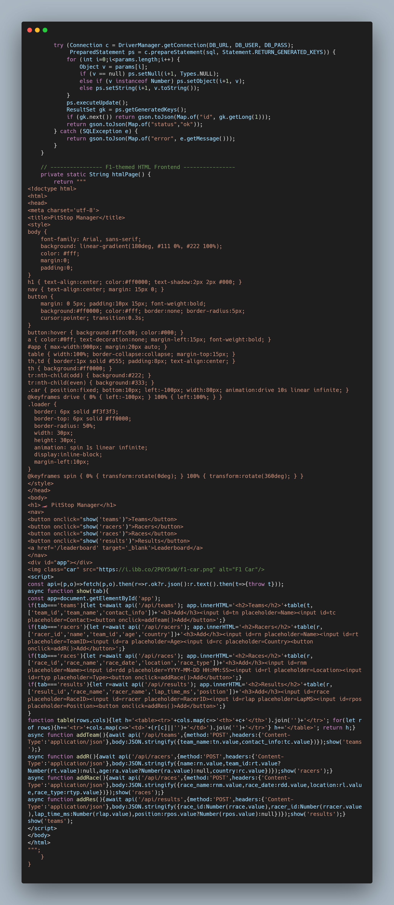
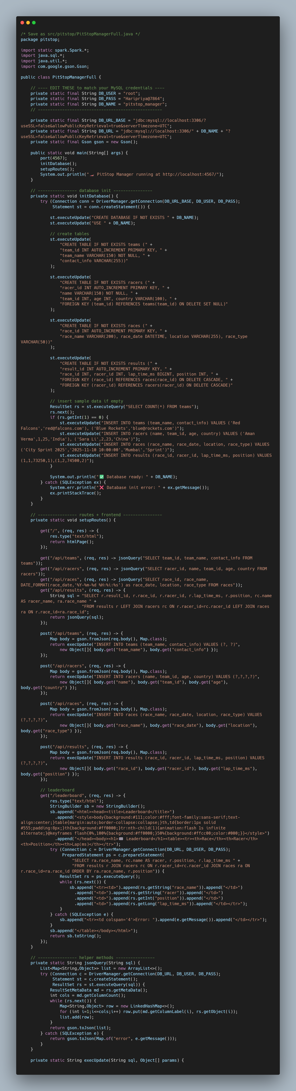
VS CODE:

Slide 12
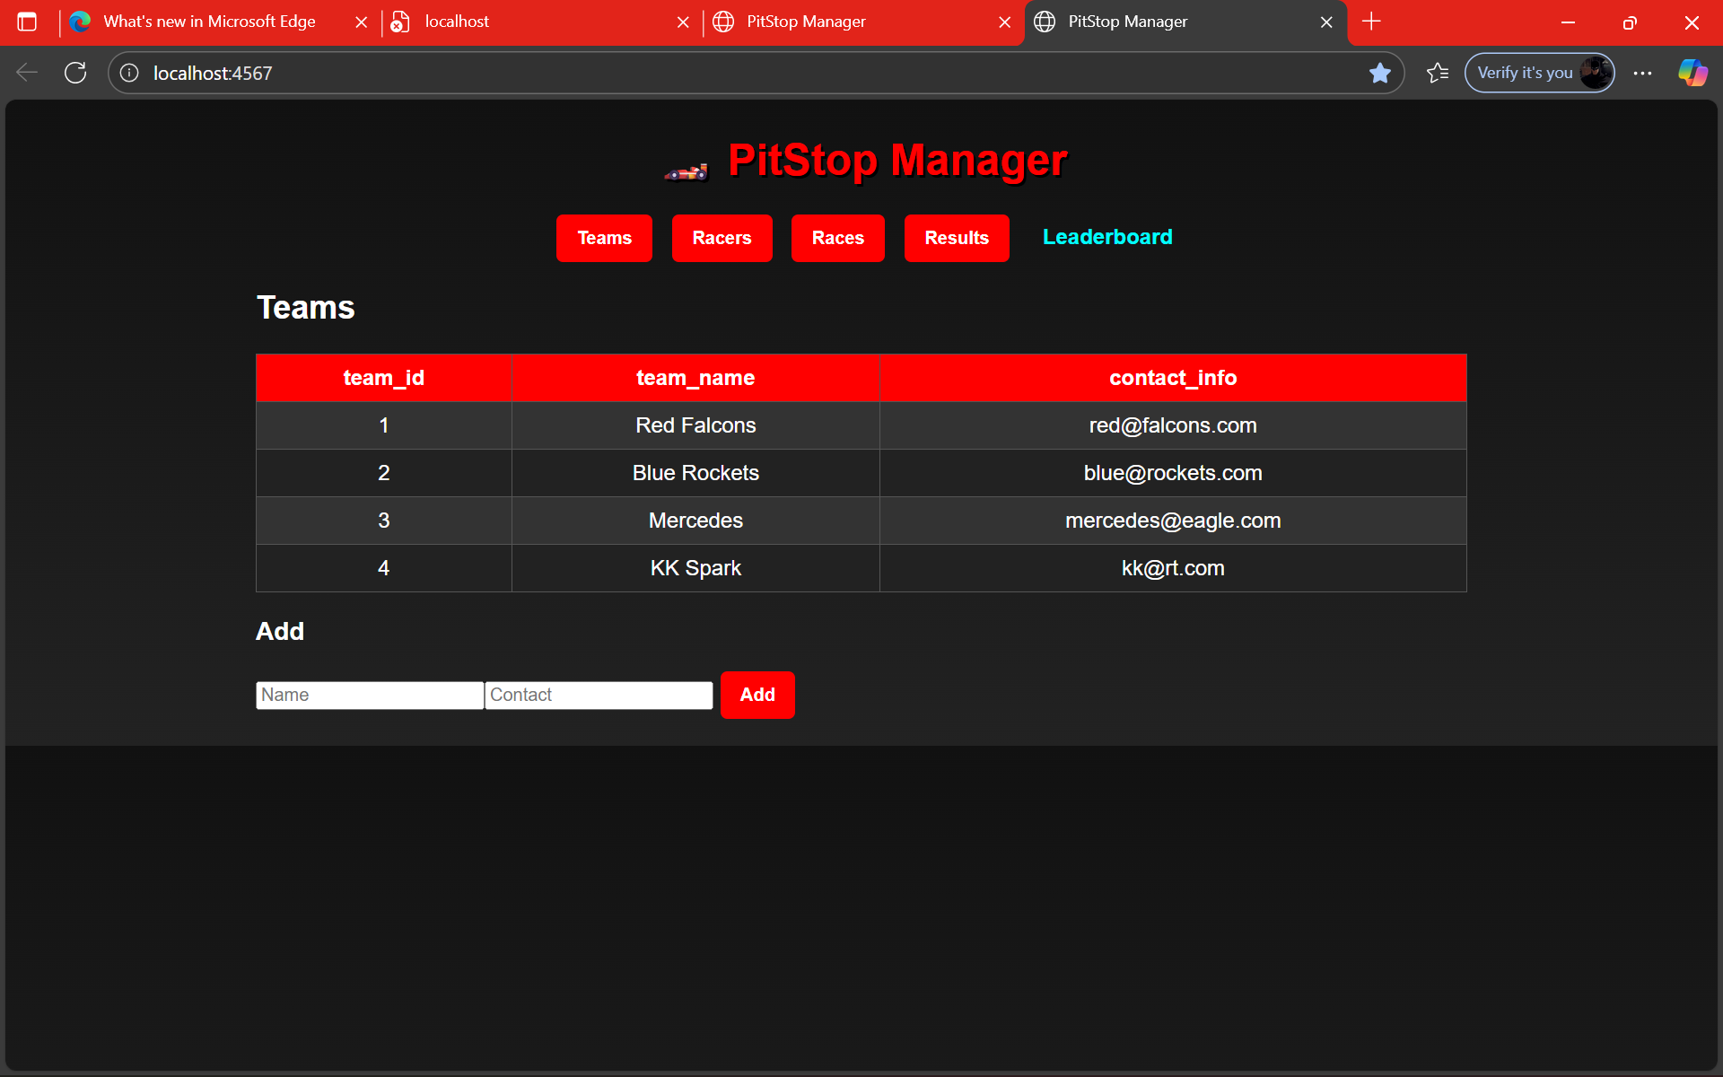
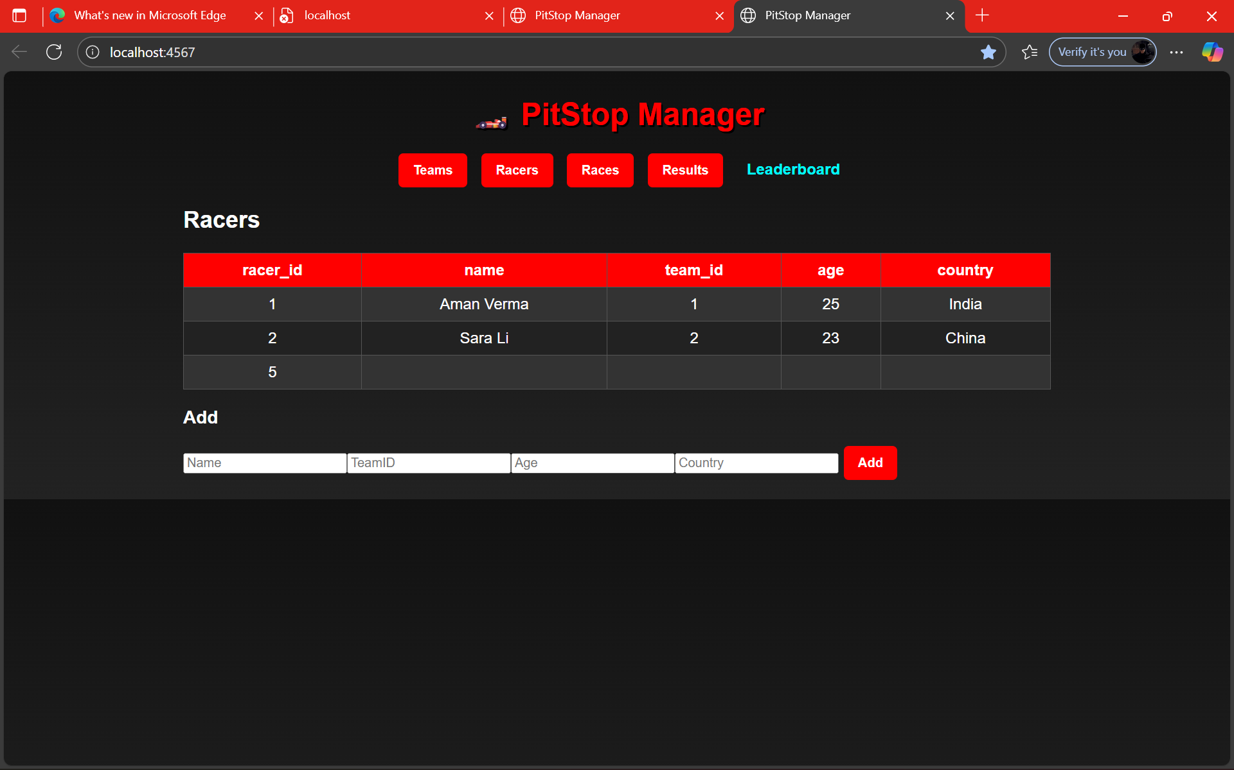
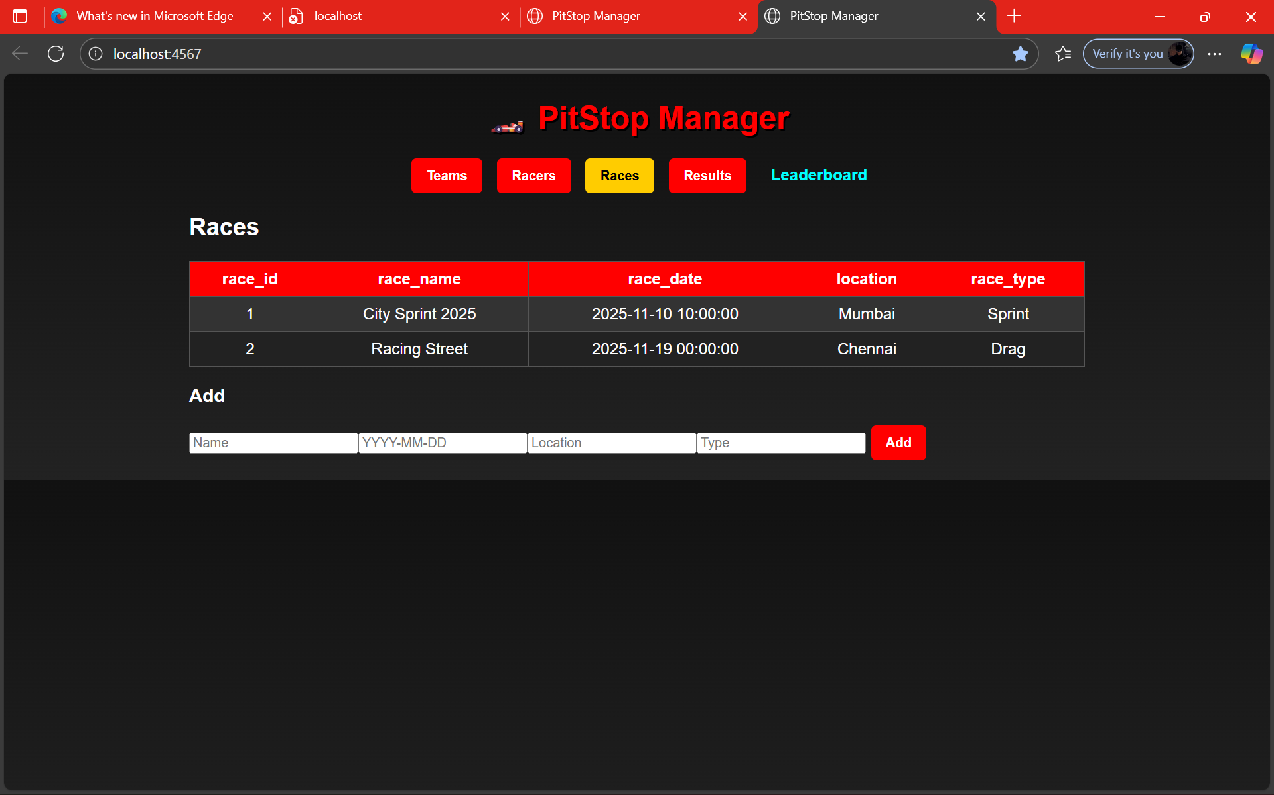
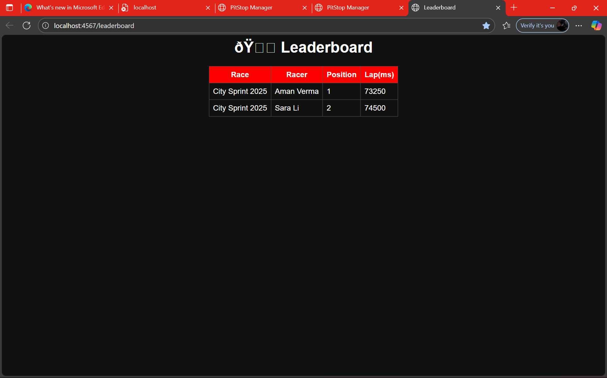
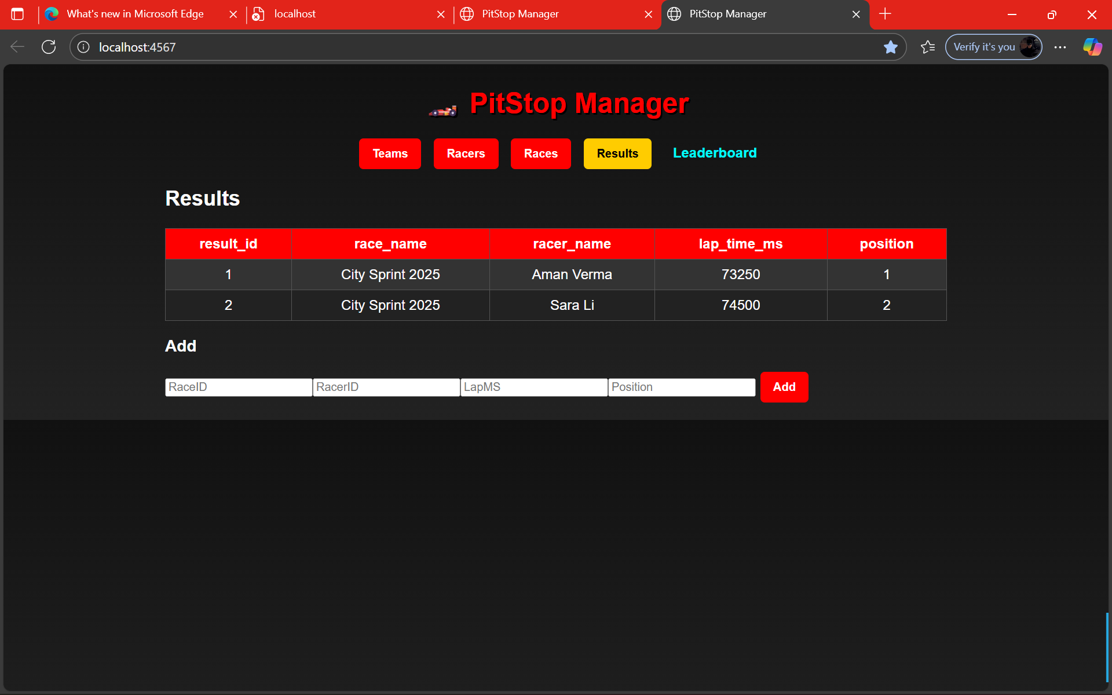
OUTPUT:

Slide 13
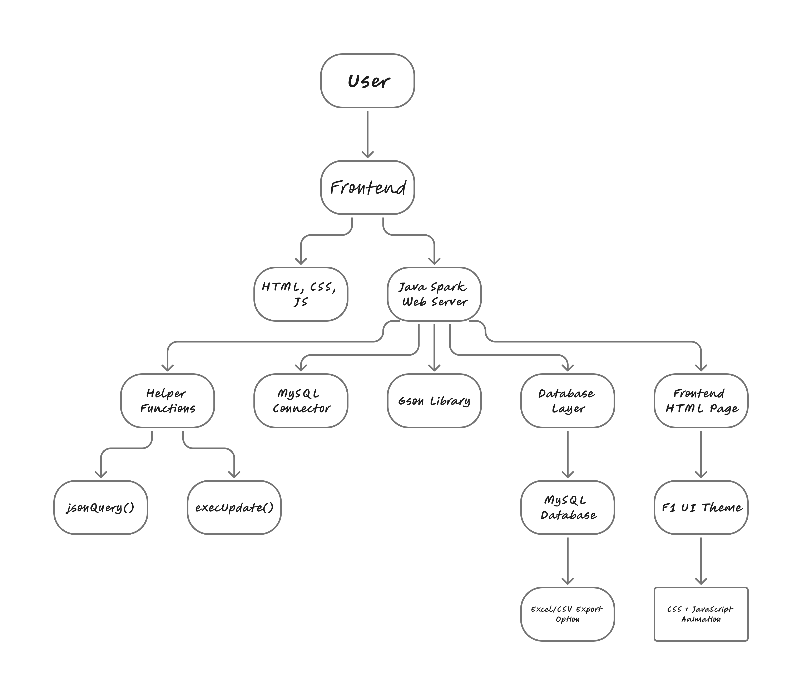
TREE DIAGRAM:

